Slide 1
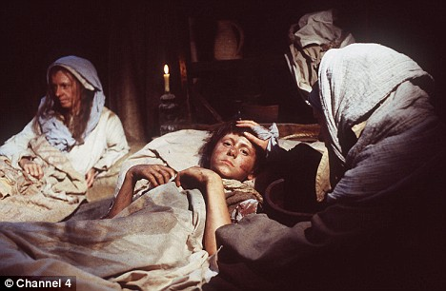
There was no remedy except to run away from the Black Death

Slide 2
The Black Death had the worst impact on the population in the history of the world
25 million people died in just under five years between 1347 and 1352. Estimated population of Europe from 1000 to 1352

Slide 3
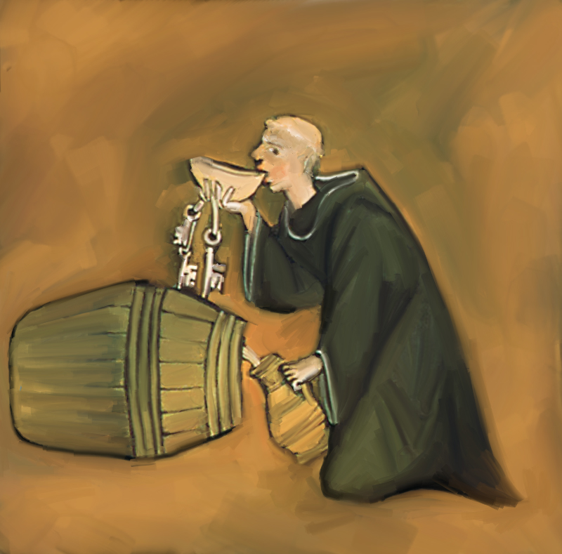
Everyone thought that they would die

Slide 4
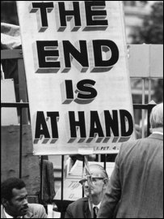
Some treated each day as if it were their last

Slide 5
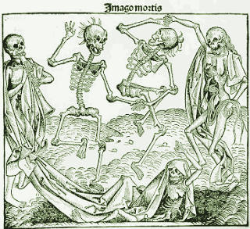
Even the art and building design changed in Britain as a result of the Black Death

Slide 6
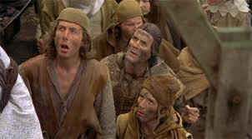
Peasants and labourers were the hardest hit part of society by the Black Death

Slide 7
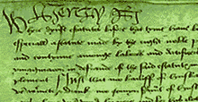
The King panicked. He wrote a new law called Statute of Labourers in 1351. This law sought to prevent labourers from obtaining higher wages.

Slide 8
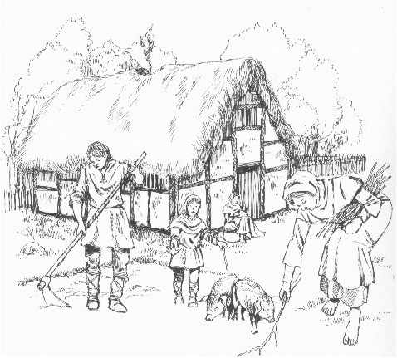
Despite the shortage in the workforce caused by the plague, workers were ordered to take wages at the levels achieved pre-plague.

Slide 9
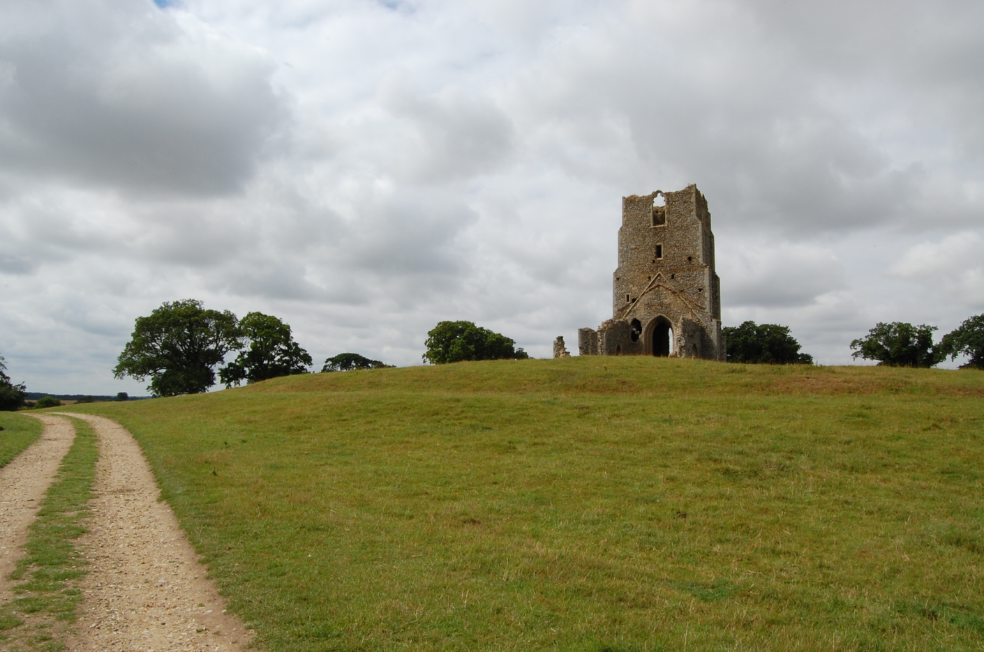
land fell waste for want of tenants who used to cultivate it and many villages and hamlets were deserted and never inhabited again.

Slide 10
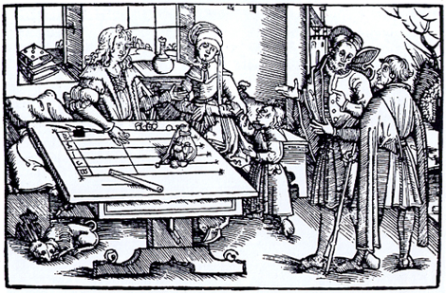
Income from rents dwindled (fell)

Slide 11
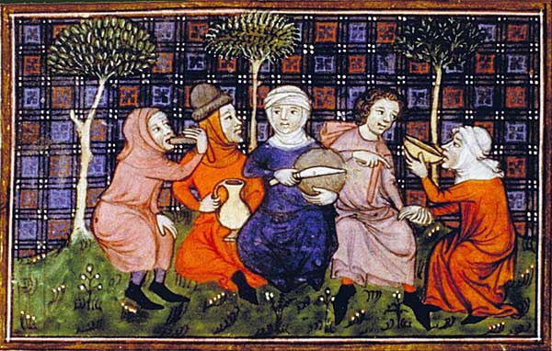
In 1363 a new law was brought through parliament. This measure decreed not only the quality and colour of cloth that people at different levels of society (below the nobility) should use in their dress, but also sought to limit the common diet to basics.

Slide 12
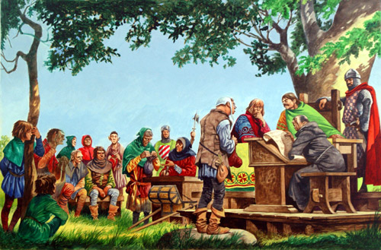
The Poll Tax was an unsuccessful attempt by the government to combat the effects of plague by changing the basis of taxation from a charge on villages to a tax on individuals. This meant peasants had to pay more tax!

Slide 13
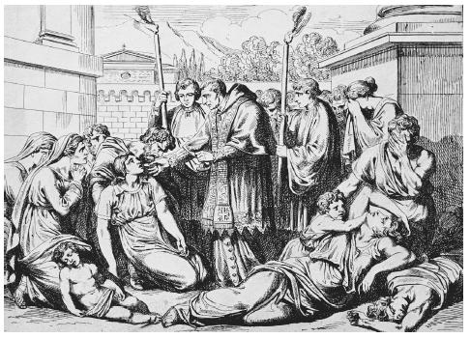
Religious people were just as likely to be killed than those who were not monks or priests. Many lost their faith in God.

Slide 14
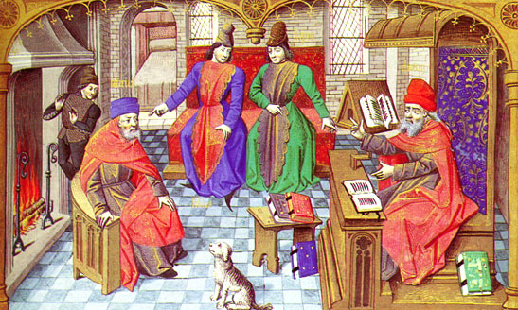
There was a sudden decline in trade

Slide 15
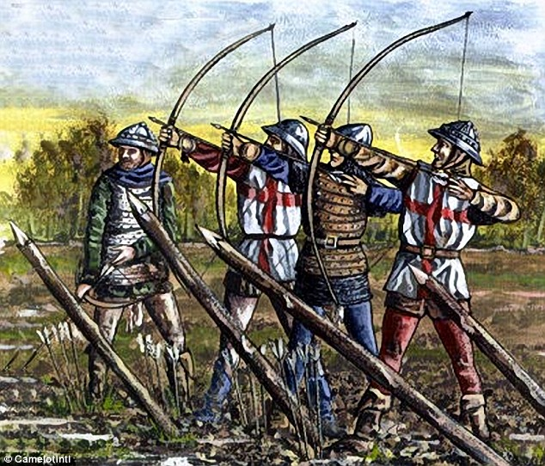
Wars were halted

Slide 16
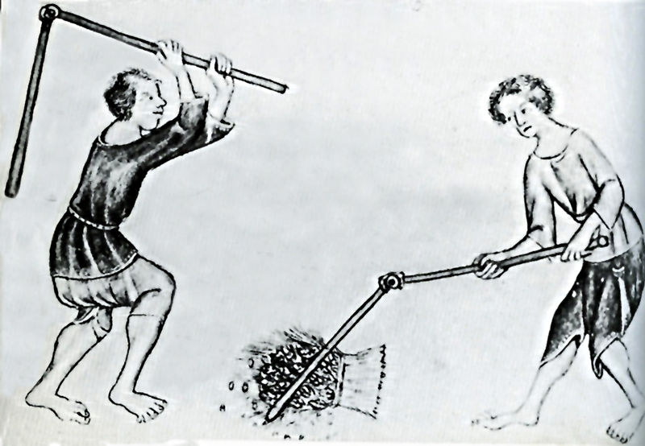
The cost of labour increased as there were less labourers

